Slide 1
Disaster waste management efforts in Hyogo Prefecture
Marking 30 years since the Great Hanshin-Awaji Earthquake
Nobuyuki Takahara, Chief of the Environmental Improvement Division, Hyogo Prefecture Environment Department
2024.12.17 SDGs International Forum @ Lasse Hall

Slide 2
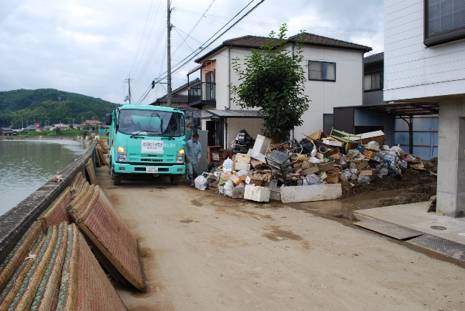
Contents
Great Hanshin-Awaji Earthquake
Chapter 01
Disaster waste disposal from the Great Hanshin-Awaji Earthquake
01
Typhoon No. 9 of 2009 (Sayo Town)
05
Subsequent major disaster responses
Chapter 02
08
Disaster relief support
Chapter 03
11
Heavy rain in August 2014 (Tamba City)
Disaster waste management training
Chapter 04
Looking back from the Great Hanshin-Awaji Earthquake to the Noto Peninsula Earthquake
12

Slide 3
Disaster waste disposal from the Great Hanshin-Awaji Earthquake
Earthquake occurrence status
Overview of the damage
Name | Southern Hyogo Prefecture Earthquake (Great Hanshin-Awaji Earthquake)
Date and time of occurrence | January 17, 1995, 5:46 AM
Epicenter | Northern Awaji Island
Scale and intensity | Magnitude 7.3, maximum seismic intensity 7
Depth of epicenter | 16km
Disaster Relief Act Number of designated cities and towns | 10 cities and 10 towns | Totally destroyed | 104,004 Buildings
Casualties | 6,402 people | Partially destroyed | 136,952 Buildings
Injured | 40,092 people
Missing persons | 3 people | Partially damaged | 297,811 Buildings
Amount of disaster waste generated
 | Original Prefectural Plan | Revised Prefectural Plan | Achievements
Housing and Buildings | 13 million tons | 14.5 million tons | 14.3 million tons
Public facilities | 5.5 million tons | 5.5 million tons | Approximately 5.5 million tons
Total | 18.5 million tons | 20 million tons | Approximately 19.8 million tons
Recycling rate
(Achievements)
50.7％
The amount of general waste generated in 1994 was 2.48 million tons. → Disaster waste generated is equivalent to eight years’ worth of general waste.
34 temporary incinerators and 33 crushers will be installed in addition to existing facilities in cities, towns, and villages within the prefecture.
Off-site processing: 1.43 million tons (244,000 tons incinerated, 1,193,000 tons landfilled)
Landfill at Phoenix, Osaka Bay: 450,000 tons of incineration ash, 2 million tons of non-combustible materials
Notes:
約1,980万t

Slide 4
Disaster waste disposal from the Great Hanshin-Awaji Earthquake
Sewage treatment
Sewerage coverage rate in the Hanshin area is 95%; flush toilets unusable due to water outage.
Temporary toilets |  | Vacuum trucks
1/18 | 300 units provided by the Kobe City Safety Cooperation Association The prefecture secured temporary toilets (approximately 9,200 at the peak). | 1/18 | 32 vehicles secured with support from cities and towns in the prefecture
～1/27 | Provision of the necessary number of temporary toilets (3,900 units with the prefecture’s cooperation) | ～1/25 | 221 vehicles secured, including support from other prefectures
～1/31 | Installation completed in Kobe City Collection system to be established in late February
Maintenance of temporary toilets
Requests were made to city and town licensed and contracted businesses, the National Federation of Environmental Improvement Business Cooperative Associations, and the Water Quality Conservation Center. The prefecture’s emergency measures will end on February 4. → Operations will be transferred to cities and towns.
Handling household waste
Collection and transportation |  | Waste treatment facility
1/19 | Garbage collection began in each city. | Around 1/24 | 20 facilities were damaged. → 13 facilities temporarily restored
～1/31 | Traffic conditions between Kobe and Hanshin have worsened, and collection rates are about 50% of normal. | 2/20 | All facilities restored Support from other cities and towns 44 organizations Incineration volume: 11,620t
1/31 | Returned to normal Kobe City requested the deployment of the Self-Defense Forces. Some cities provided support to other cities and towns (163 organizations, total of 4,155 vehicles).

Slide 5
Disaster waste disposal from the Great Hanshin-Awaji Earthquake
Disaster waste disposal business
Demolition costs
Handling the demolition and disposal of damaged houses, etc.
[Before the disaster]
Handling of demolition work expenses
[Before the disaster]
Demolition was the owner’s responsibility.
After demolition, the municipality will process the waste.
The national government subsidized municipalities’ waste disposal costs (1/2).
Disaster waste disposal business
Demolition work expenses were not covered (0%).
At the local disaster response headquarters,
Prefectures and other local governments made strong requests to the national government.
Request from prefecture to national government official → Ministry of Finance not allowed
Mid-February: Direct request to the Director of the Ministry of Health, Labour and Welfare during his visit to the prefecture
[After the disaster (1/28)]
[After the disaster (2/28)]
Municipalities dismantled and processed the items as waste.
The national government subsidized municipalities’ waste disposal costs (1/2).
Dismantling costs were also subsidized.
Got active cooperation from the Self-Defense Forces
The costs of demolition work were clearly stated in the grant guidelines.
(The same applies to construction work.)

Slide 6
Disaster waste disposal from the Great Hanshin-Awaji Earthquake
Lessons learned from the disposal of disaster waste from the Great Hanshin-Awaji Earthquake
1. Strengthening wide-area cooperation
2. Stockpiling temporary toilets, etc.
3. The need for temporary storage facilities
4. The need for planned demolition
5. Importance of separation at demolition sites
6. Securing transportation routes
7. Capacity of waste treatment facilities
8. Technological Development
A current issue that still exists!

Slide 7
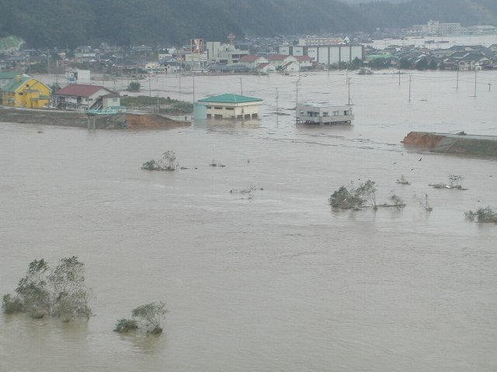
Subsequent major disaster responses
Broken embankment of the Maruyama River (Tateno, Toyooka City)
Typhoon No. 23 of 2004
Date and time of occurrence | October 20, 2004
Scale | Maximum rainfall in 24 hours: 309 mm
 | Maximum rainfall per hour: 71.5 mm
Disaster Relief Act applicable cities and towns | 5 cities and 13 towns ( Tajima, Awaji, Kita-Harima, Tamba )
Totally destroyed | 783 buildings
Partially destroyed | 7,142 buildings
Partially damaged | 1,506 buildings
Flooding above the floor | 1,745 buildings
Flooding under the floor | 9,058 buildings
Disaster waste | 67,391 t
Incineration support
20 cities and 6 administrative associations in the prefecture and Osaka Prefecture
Cooperation and support for sewage and garbage collection
[Sewage] 3 cities in the prefecture (13 vehicles), Water Quality Conservation Center (54 vehicles)
[Garbage] 18 cities and 24 towns in the prefecture (865 vehicles), Kobe City Safety Cooperation Association (730 vehicles), Hyogo Prefecture Industrial Waste Association (68 vehicles)
[Temporary toilets] 321 units installed in four cities and towns (Toyooka City, Sumoto City, Nishiwaki City, Izushi Town)

Slide 8
Subsequent major disaster responses
A support agreement was concluded based on lessons learned from the response to Typhoon No. 23 in 2004.
1. Hyogo Prefecture Disaster Waste Disposal Mutual Support Agreement (September 1, 2005)
2. Support agreement regarding waste disposal in the event of a disaster
Agreement signatory | Prefectures, cities, towns, and administrative associations
Contents of the Agreement | ① The prefecture will respond to requests from affected cities and towns and coordinate giving and receiving of support. ② Mutual support between cities and towns
Cost burden | In principle, the cities and towns that requested support Garbage collection is free (subject to local tax allocation); incineration etc. are paid for (contracted).
Agreement signatory with the prefecture | Hyogo Prefecture Industrial Resource Recycling Association (September 2005), Kobe City Safety Cooperation Association (September 2005), Hyogo Prefecture Water Quality Conservation Center (January 2006), Hyogo Prefecture Environmental Improvement Business Cooperative (July 2012), Japan Construction Federation Kansai Branch (July 2012), Hyogo Prefecture Environmental Business Commerce and Industry Association (December 2014)
Contents of the Agreement | ① The prefecture receives requests from affected cities and towns and asks for support from and coordinates support requests with each organization. ② Organizations provide support to affected cities and towns.
Cost burden | In principle, the cities and towns that requested support The portion that is eligible for national subsidies is provided by the city or town, while the rest is provided by support groups.

Slide 9
Subsequent major disaster responses
Utilizing the Hyogo Prefecture Disaster Waste Disposal Mutual Support Agreement
Heavy rain in August 2014
Typhoon No. 9 of 2009
Date and time of occurrence | August 9-10, 2009
Scale | Maximum rainfall in 24 hours: 327 mm
 | Maximum rainfall per hour: 82 mm
Disaster Relief Act Applicable cities and towns | 2 cities and 1 town ( Sayo Town, Shiso City, Asago City )
Totally destroyed | 166 buildings
Partially destroyed | 305 buildings
Partially damaged | 638 buildings
Flooding above the floor | 334 buildings
Flooding under the floor | 1,494 buildings
Disaster waste | 25,929 t
Incineration support | 10 cities and 2 administrative associations in the prefecture
Collection support | 37 cities, towns and administrative associations in the prefecture
Date and time of occurrence | August 16-17, 2014
Scale | Maximum rainfall in 24 hours: 392 mm
 | Maximum rainfall per hour: 75 mm or more
Disaster Relief Act Applicable cities and towns | 1 city ( Tamba City )
Totally destroyed | 15 buildings
Partially destroyed | 51 buildings
Partially damaged | 1 building
Flooding above the floor | 168 buildings
Flooding under the floor | 783 buildings
Mud flow | 72 cases (Tamba City)
Disaster waste, etc. | Debris, driftwood, etc.: 6,692 t Soil: 54,460 m3
Collection support | 15 cities and towns and 1 administrative association
As with the landslide in Hiroshima City, the debris mixed with soil is dealt with through disaster waste disposal projects.

Slide 10
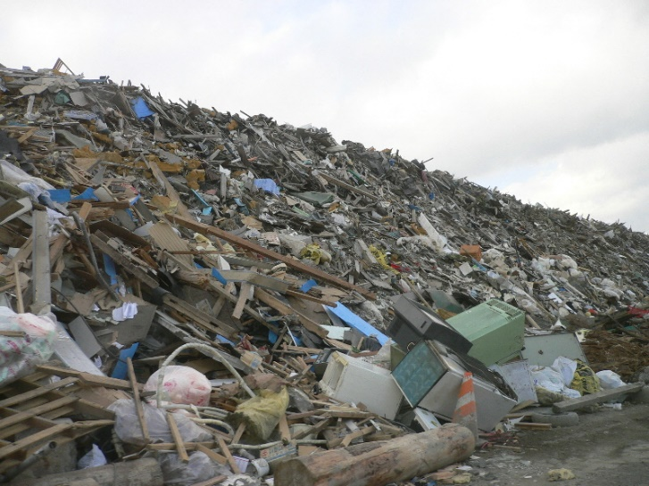
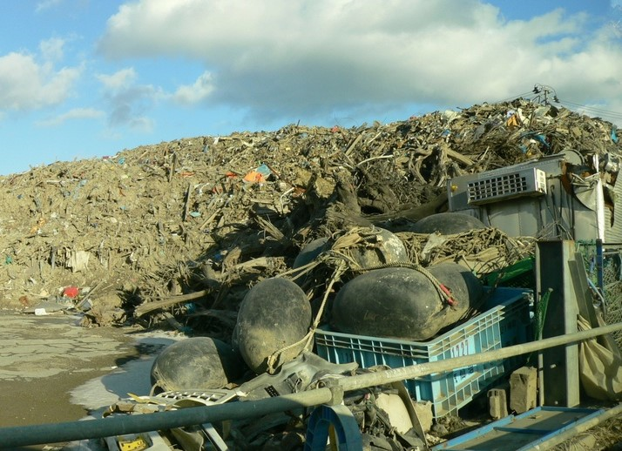
Disaster Support [Great East Japan Earthquake 2011]
Main support
Temporary storage site (Miyako City)
Item | Contents
Provision of temporary toilets | Hyogo Prefecture, Kobe City, Nishinomiya City, Sayo Town → Miyagi Prefecture, Sendai City
Vacuum truck dispatch | Hyogo Prefecture Environmental Improvement Business Cooperative Association → 7 vehicles to Iwate Prefecture
Garbage truck dispatch | Including requests from Hyogo Prefecture to cities and towns within the prefecture, Toyooka City, Himeji City, Akashi City, Kobe City, Nishinomiya City, Takarazuka City, Kawanishi City, and Inagawa Town → Misato Town, Osaki City, Ishinomaki City, Kesennuma City, Minamisanriku Town 25 dump trucks and packers, total of 418 personnel dispatched
Staff Dispatch | ○ Advice on disaster waste disposal Hyogo Prefecture, Amagasaki City, Nishinomiya City, Takarazuka City (total of 12 people) → Miyagi Prefectural Government, Local Support Headquarters (Kesennuma, Minamisanriku, Ishinomaki) (3/16～4/4) ○ Support for debris removal, waste volume forecasting, waste disposal plan formulation, house demolition work, etc. Kobe City, Amagasaki City, Nishinomiya City, Ashiya City, Yabu City (total of 47 people) → Sendai City, Kesennuma City, Iwate Prefecture, Onagawa Town, Ishinomaki City, Shiogama City (3/25～3/31 (H25))
Temporary storage site (Kesennuma City)

Slide 11
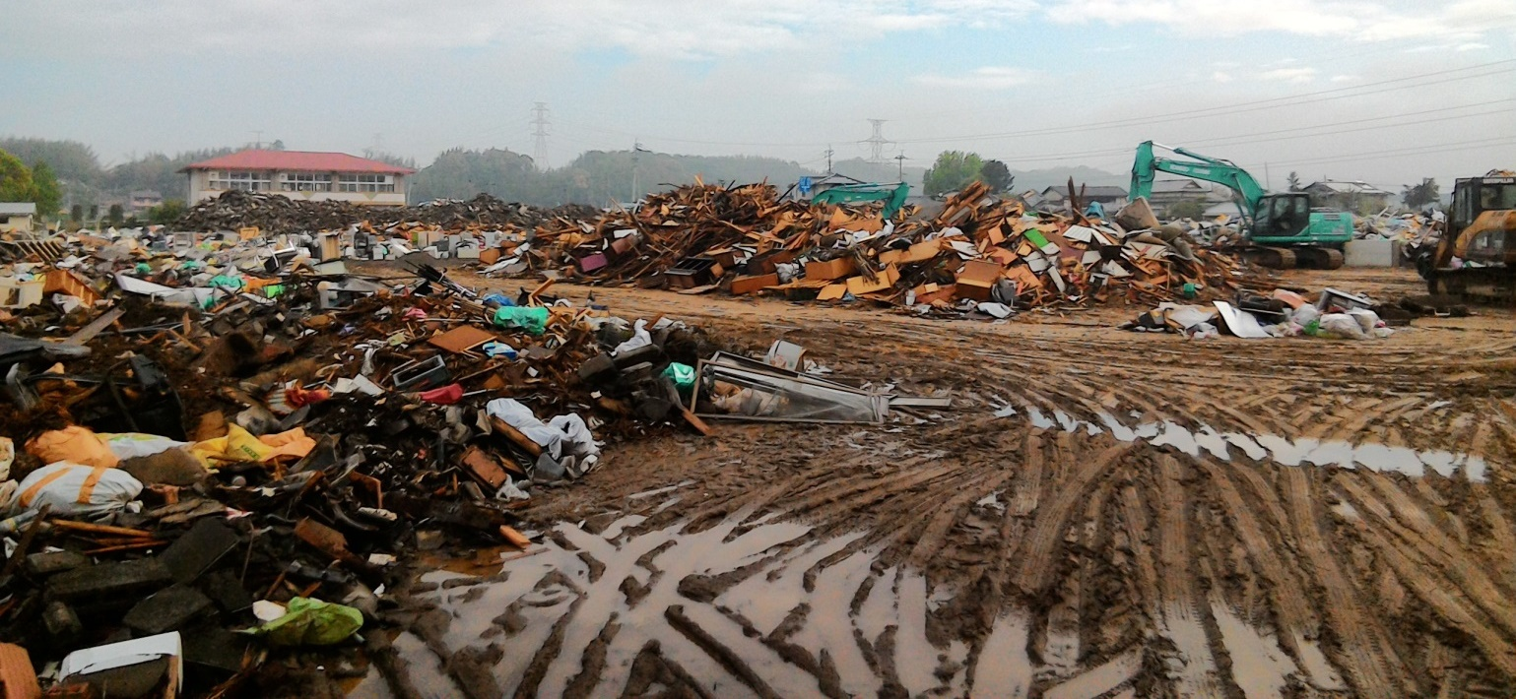
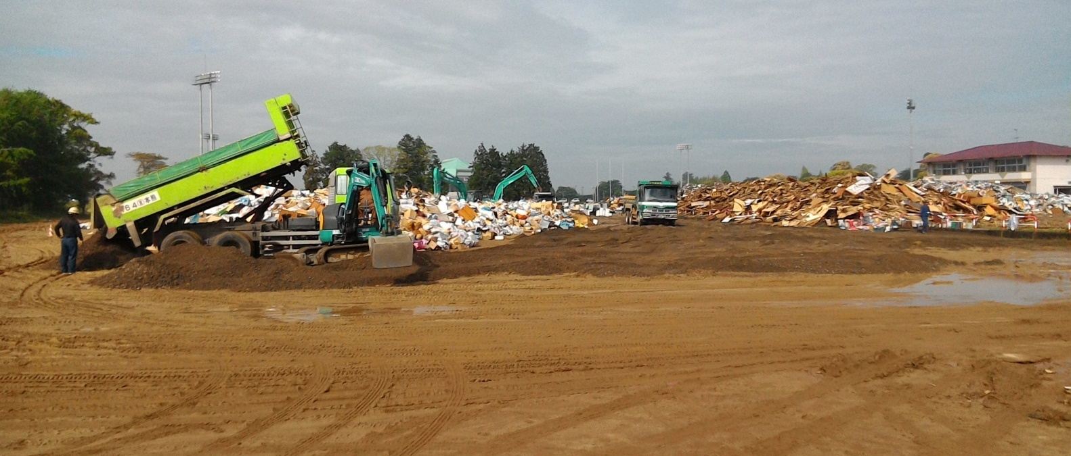
Disaster Support [2016 Kumamoto Earthquake]
Hyogo Prefecture, which is in charge of the Regional Disaster Prevention Bureau of the Union of Kansai Governments, set up a local liaison office in Mashiki Town, Kumamoto Prefecture, as a first response.
Primary temporary storage site (Mashiki Town)
Team Composition
Headquarters (1)
Researcher, Disaster Reduction and Human Renovation Institution
Information gathering liaison officer (1)
Logistics Manager (3)
Educational support staff (2)
Volunteer General Coordinator (2)
Evacuation shelter management support staff (2)
Health, Medical and Welfare Liaison Officer (3)
Public Health Nurse (4)
Environmental measures such as debris disposal (2)
Primary temporary storage site (Mashiki Town)
Dispatch Period
April 20 to October 27, 2016 (First batch: until April 27)
Dispatched personnel
Debris disposal and other environmental measures: 2 people
→ Wakayama Prefecture took over from the second batch onwards, ending with the 10th batch.

Slide 12
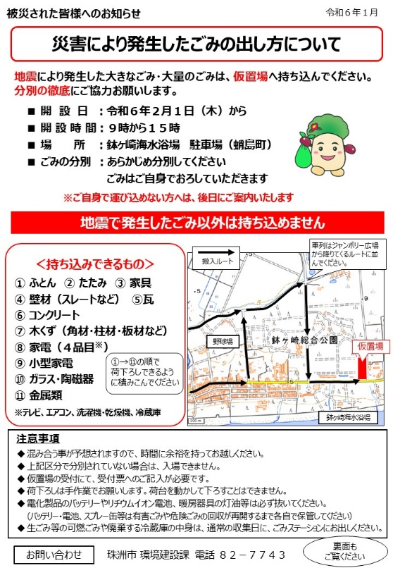
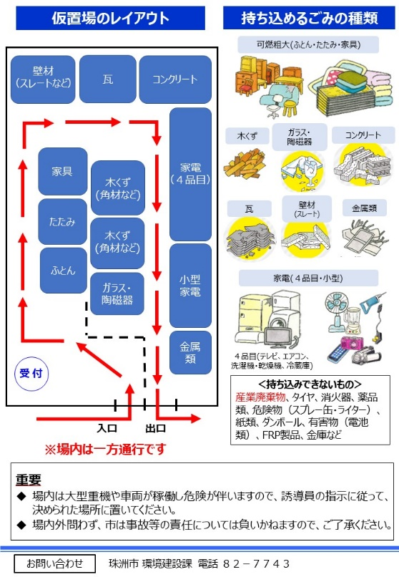
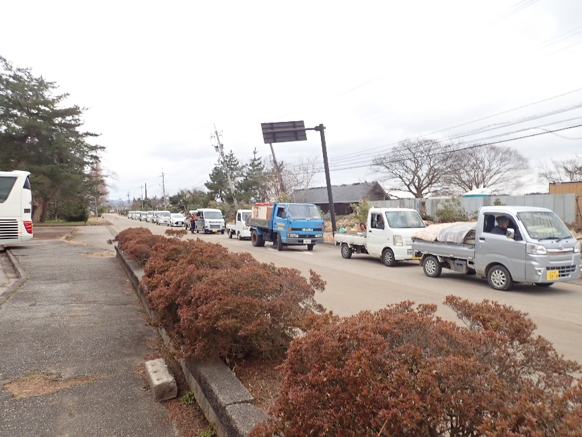
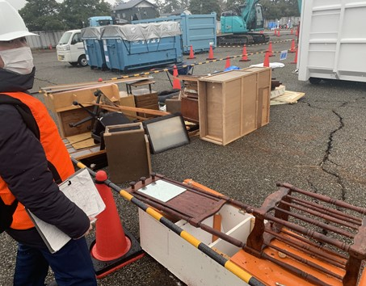
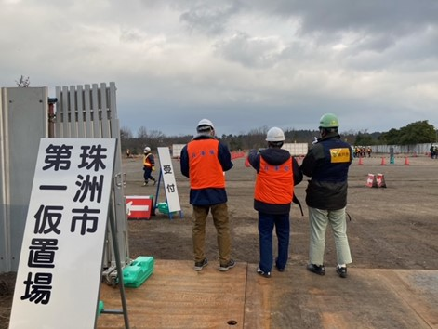
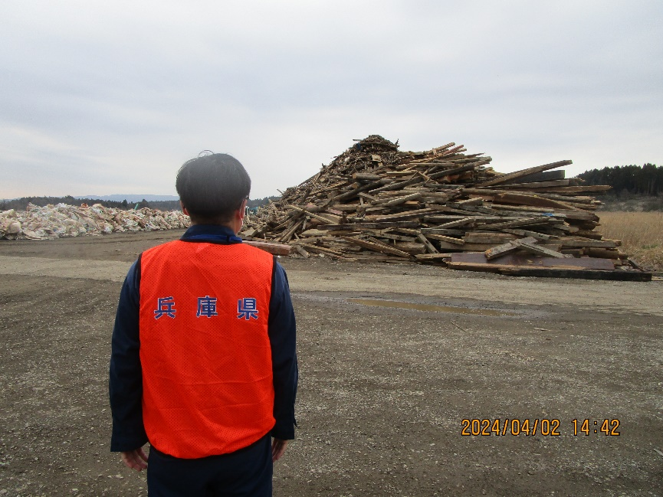
Disaster relief [2024 Noto Peninsula earthquake]
Publicity flyer
Support from the Union of Kansai Governments: Hyogo Prefecture → Suzu City
Support System
Hyogo Prefecture: 2 people each for environmental science positions → 1/11 to 4/26: 43 people in total
Kobe City Environment Bureau staff, one each → 1/20 to 3/31: 6 people in total
Support details
Providing detailed advice from the same perspective as city officials
1. Sewage and evacuation center waste collection services
Establishment of information gathering system for evacuation centers and collection vehicle operation planning system
2. Dealing with garbage disposal
Support for creating layouts for sorting wastes at temporary storage sites and support for their establishment
3. Dealing with demolition debris
Support for creating layouts for sorting wastes at temporary storage sites and support for their establishment, etc.
Status of temporary storage facilities

Slide 13
Disaster waste management training
Training status
Hyogo Prefecture Disaster Waste Management Cooperator System
Fiscal year | Contents | Participants
2014 | Lectures and Workshops | 46 from cities, towns, etc., and 6 from prefectures
2015 | Lectures and tabletop exercises | 35 from cities, towns, etc., and 7 from prefectures
2016 | Lectures and tabletop exercises | 47 from cities, towns, etc., and 7 from prefectures
2017 | Lectures and tabletop exercises | 30 from cities, towns, etc., and 5 from prefectures
2018 | Lectures and tabletop exercises | 119 from cities, towns, etc., and 18 from prefectures
2019 | Lectures and tabletop exercises | 42 from cities, towns, etc., and 10 from prefectures
2020 | Not held
2021 | Lectures | 62 from cities, towns, etc., and 18 from prefectures
2022 | Lectures and drills | 50 from cities, towns, etc., and 6 from prefectures Business operators: 10 people
2023 | Lectures | 42 from cities, towns, etc., and 16 from prefectures
2024 | Mock training (planned)
1. Establishment body
Hyogo Environmental Creation Association (Public Interest Foundation)
2. Activities
① Advice and support for disaster waste disposal projects carried out by affected cities and towns in the event of a large-scale disaster
② Advice and support for the formulation of city and town disaster waste disposal plans
③ Community activities and training for disaster preparedness
3. Requirements
Those who have been involved in waste disposal business and waste administration for many years and have experience in supervising disaster waste disposal and disaster waste disposal businesses.
4. Number of collaborators
15 people
It is necessary to increase effectiveness through not only lectures but also tabletop exercises and mock training.

Slide 14
Looking back from the Great Hanshin-Awaji Earthquake to the Noto Peninsula Earthquake...
Lessons learned from the Great Hanshin-Awaji Earthquake (reposted)
5. Importance of separation at demolition sites
6. Securing transportation routes
7. Capacity of waste treatment facilities
8. Technological Development
1. Strengthening wide-area cooperation
2. Stockpiling temporary toilets, etc.
3. The need for temporary storage facilities
4. The need for planned demolition
Lessons learned from disasters up to the Noto Peninsula earthquake
1. Advance notification of waste separation and preparation for business-related disaster waste disposal
2. Ensuring quality of life during disasters and accurately grasping and sharing the needs of disaster victims
3. Securing public relations methods and utilizing ICT
4. Ensuring earthquake resistance of processing facilities, strengthening complex systems, and utilizing septic tanks
5. Strengthening regional waste disposal systems
6. Ensuring a support-receiving system
7. Establishment of an intra-agency coordination system for publicly funded demolition, etc.
8. The need for continued effective on-the-job training
Thank you for your attention.

